Slide 1
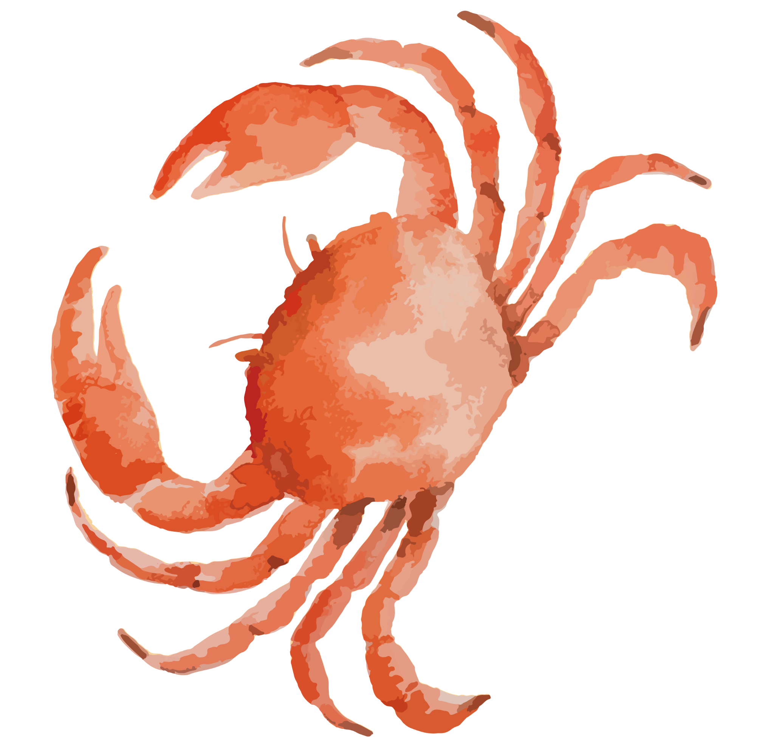
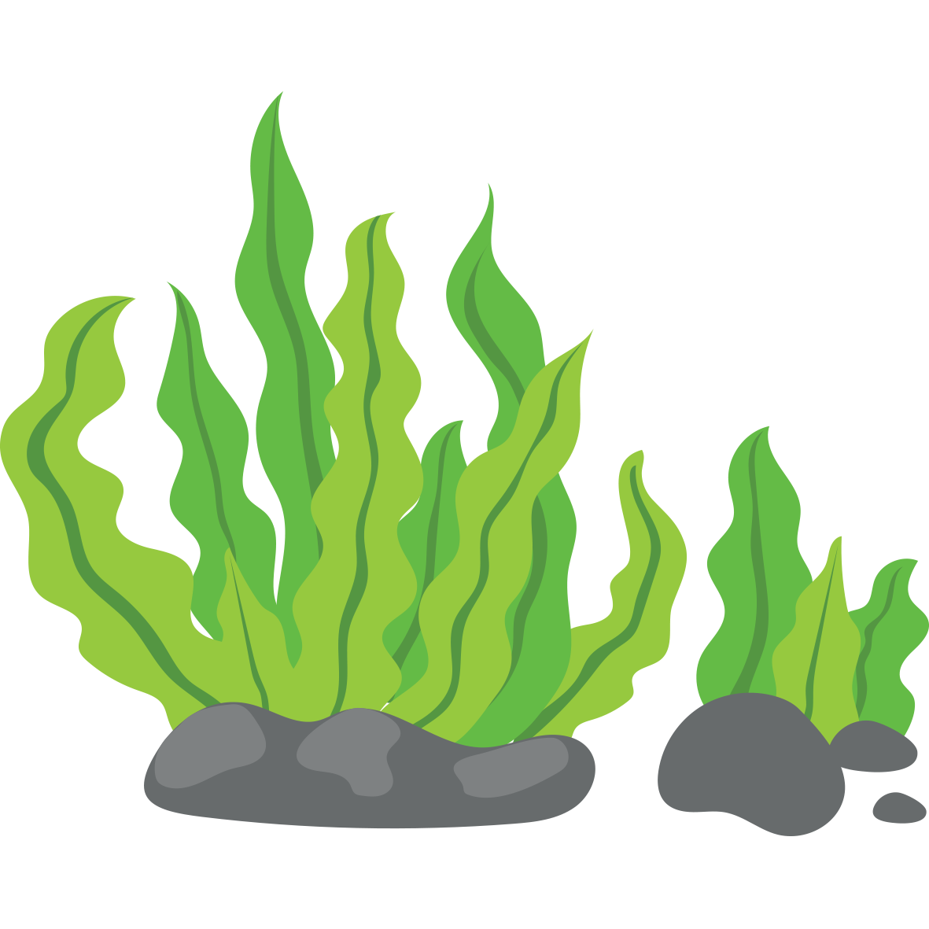
Hypoxia effects on Hemigrapsus oregonensis
GG Foster, Will Mixon, Maddy Glasser, Erik Bengtson

Slide 2
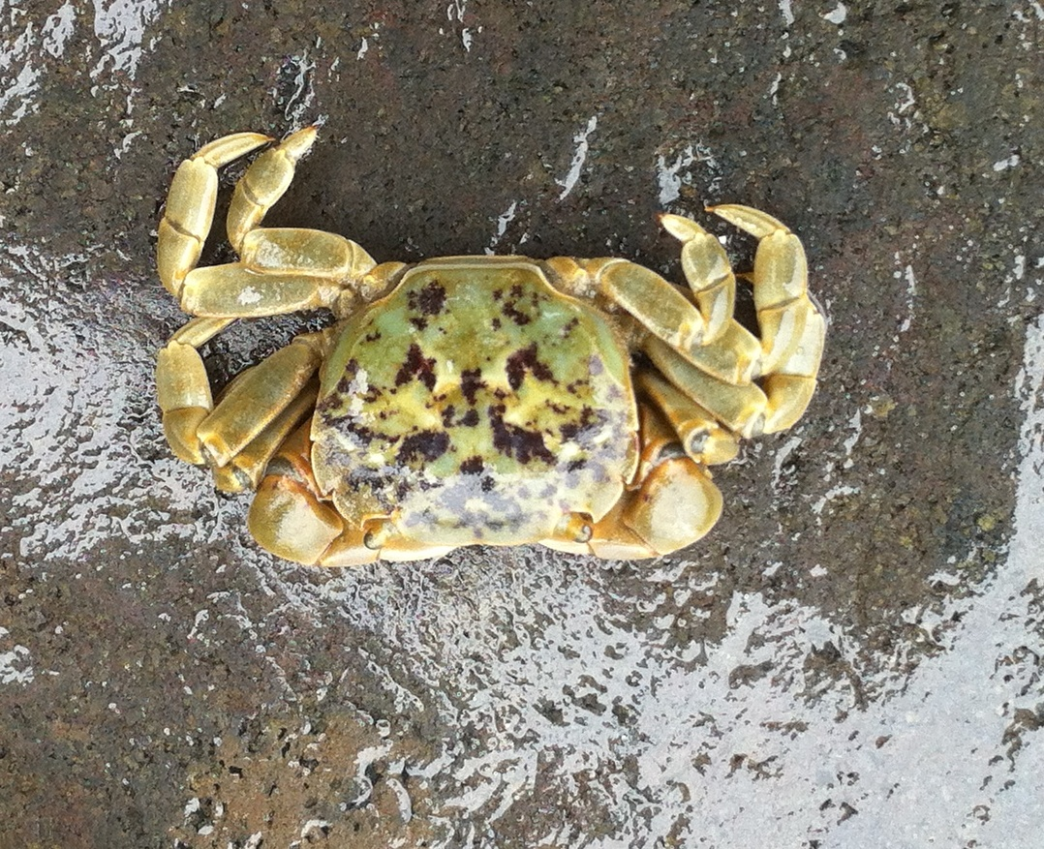
Introduction
Big Question: How does hypoxia affect crabs?
Model Species: Hemigrapsus oregonensis
Key points:
Crab fisheries in Pacific are in trouble
Hypoxia increasing
Does hypoxia in deep vs shallow water make a difference?
G.Fletcher photo

Slide 3
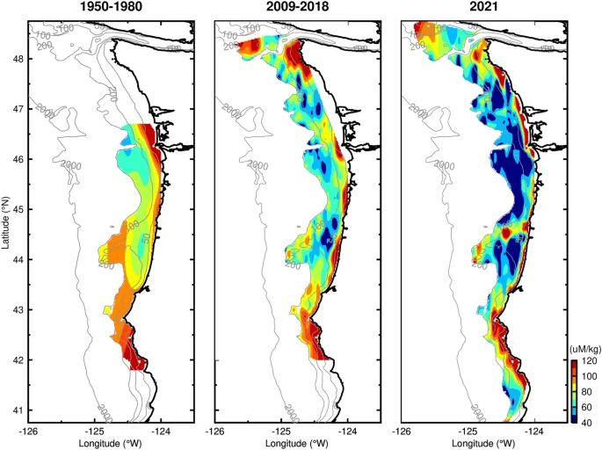
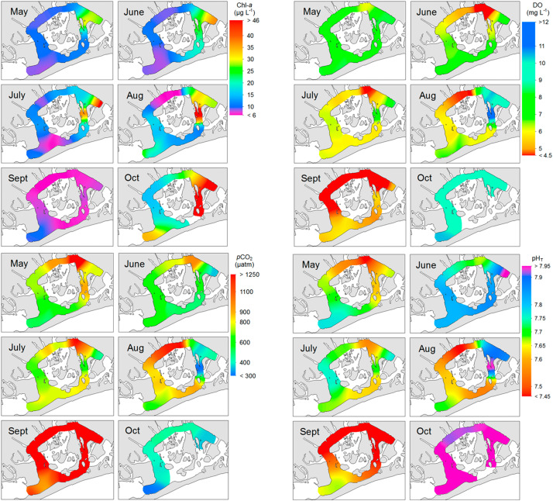
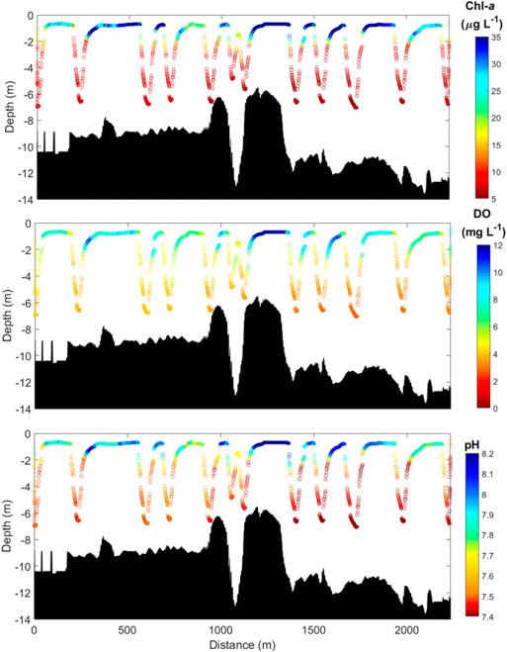
Background
Upwelling
Wind changes are occurring due to evolving land-sea temperature differences
Spring-summer transportation of cold, hypoxic water to shallow coastal habitats
Algal Blooms
Algal blooms form as temperatures rise during the spring
Raised nutrient concentrations due to runoff fuel overwhelming growth
Respiration by decomposers reduces oxygen content at depth
Barth et al., 2024
Wallace and Gobler, 2021

Slide 4
Background
What can be tested
Effects on respiration
Lactate - shift to anaerobic metabolism causes increased lactate production in the hemolymph
Respirometry with Resazurin - blue dye that when exposed to metabolically active cells reduces it to resorufin (becomes pink) by consuming oxygen; faster the change in color → more oxygen consumption, would expect a slower consumption
Other
Righting Test - Can indicate the energetic ability of the individual (do they have the energy to flip themselves back over)
Gill Tissue Wasting - Atrophic gill filaments or deteriorated gill filaments is a common result of prolonged hypoxia exposure
Threats to the commercial crab industry
Sudden increase in hypoxic conditions leading to crab decliens
Instances of severe hypoxic conditions from harmful algal blooms has significantly increased in the last few decades and impacts commercial fisheries abilities to catch crabs / enough (Barth et al, 2024)
Poor management to counteract impacts
Many fisheries do not have the management in place to combat these declines (Holland & Leonard, 2020)
Overall revenue decline
Loss of crab abundance leads to overall revenue loss, impacting companies and individuals who rely on crabbing (Holland & Leonard, 2020)

Slide 5
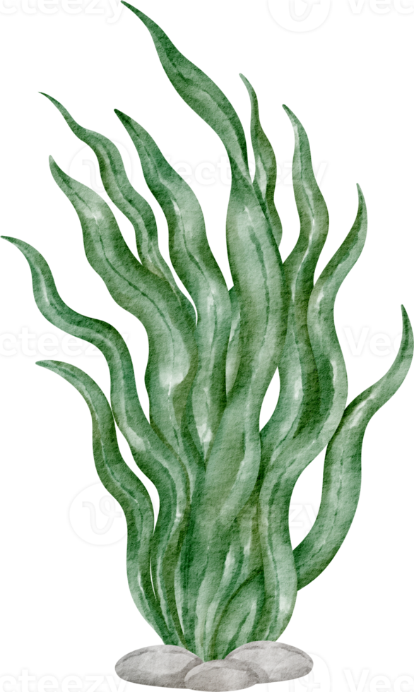
How will hypoxia affect the physiology of Hemigrapsus oregonensis?
Null: Hypoxia will not have an effect on the physiology of Hairy shore crabs.
Alternative: Hypoxia will have an effect on the physiology of Hairy shore crabs.
Expected outcomes:
Observational
Crabs with access to air will leave the water to escape the hypoxic conditions and resulting stress.
Crabs experiencing hypoxia will be lethargic.
They may have longer righting times or not be able to right themselves.
Crabs may die from long-term exposure to hypoxic water.
Gill tissues in crabs from both tanks will deteriorate but may be worse in deepwater crabs.
Experimental
Crabs will switch to anaerobic metabolism and lactate in the hemolymph will increase. Hypoglycemia may occur.
Resazurin levels could show that respiration is decreasing in hypoxic crabs due to stress.

Slide 6
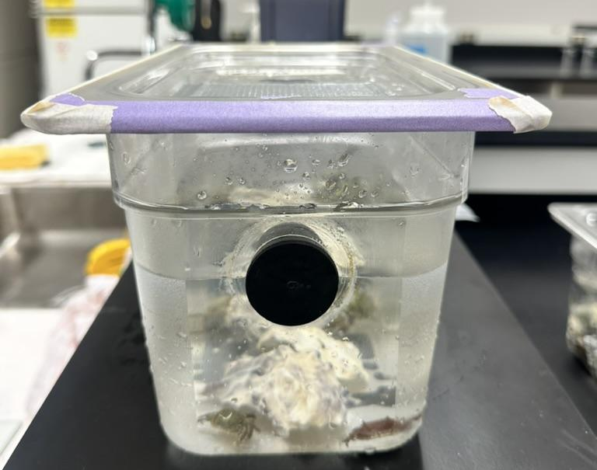
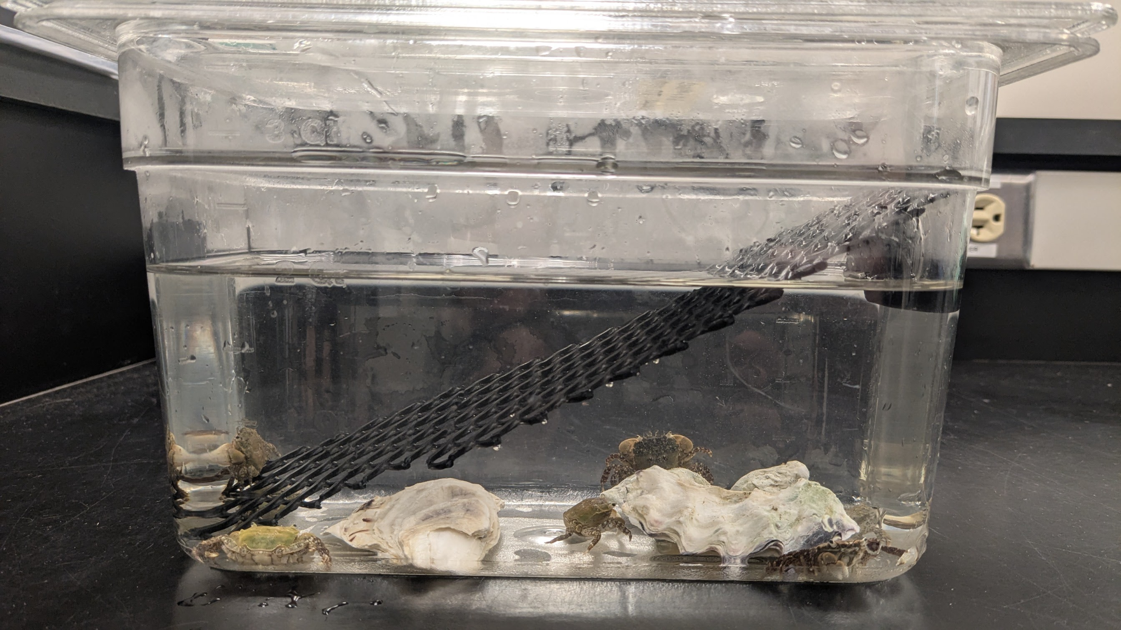
Treatment Design
Intertidal
Deepwater
Start: 7-8 ppm O2
No Airstone
Access to Surface
Start: 7-8 ppm O2
No Airstone
Two Treatments and a Control
Control tank
Hides, airstone
Intertidal
Access to surface with mesh square
Deepwater
No access to surface
Notes:
Changed to duct tape in week 2, which we believe made a much better seal

Slide 7
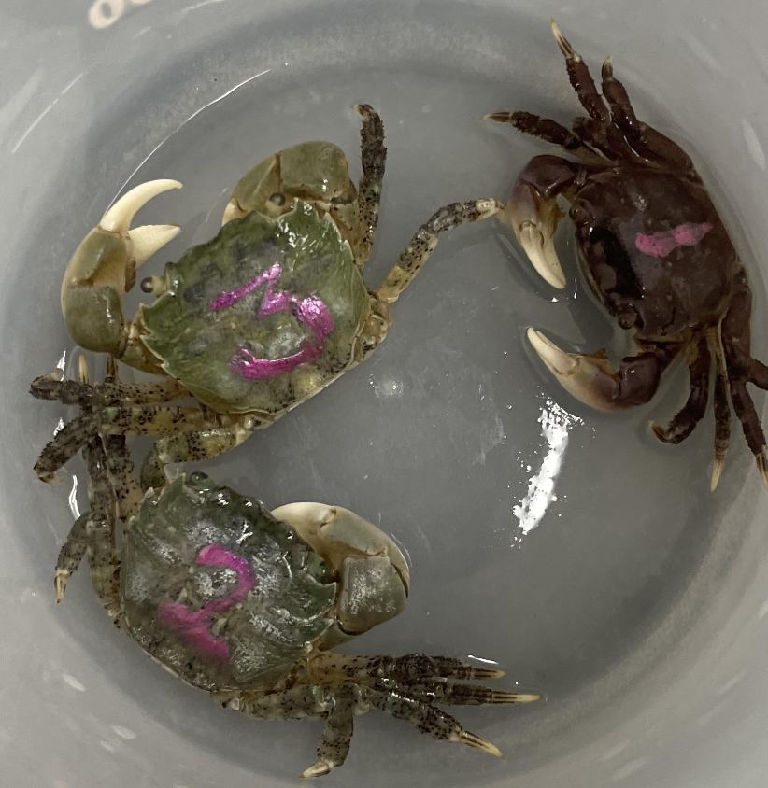
Experimental Design
After 1 week:
Non lethal tests and marking of 50% of crabs
Righting
Respiration (resazurin)
After 2 weeks
Non lethal tests on 100% of crabs
Righting
Respiration (resazurin)
Lethal tests on 100% of crabs
Hemolymph extraction for lactate analysis
Dissection for gill tissue examination
Nail polish marked crabs

Slide 8
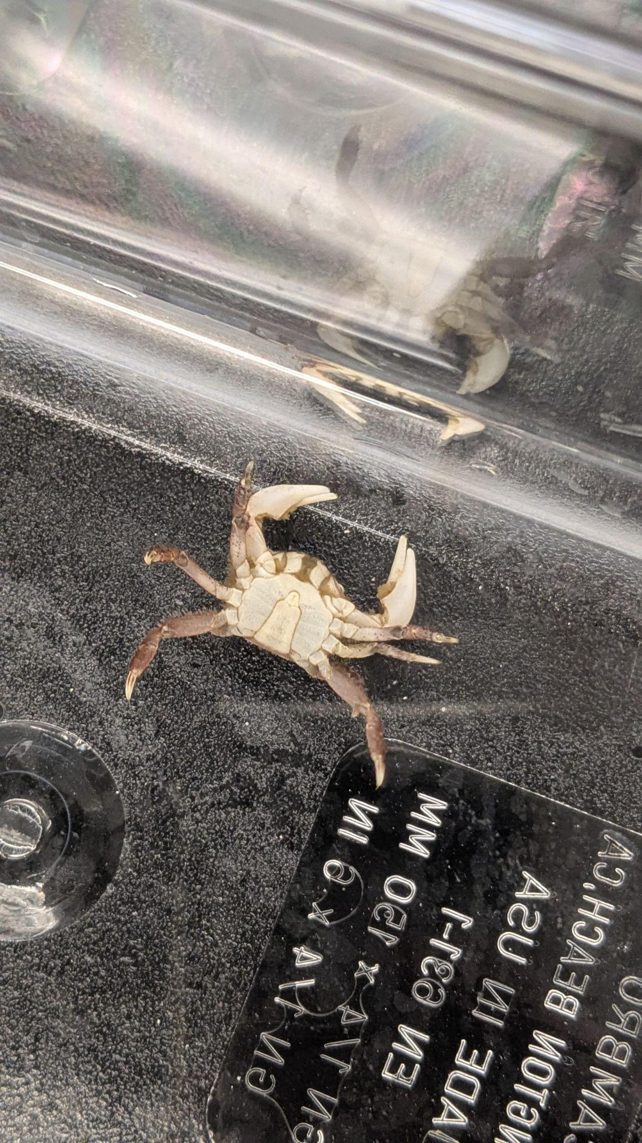
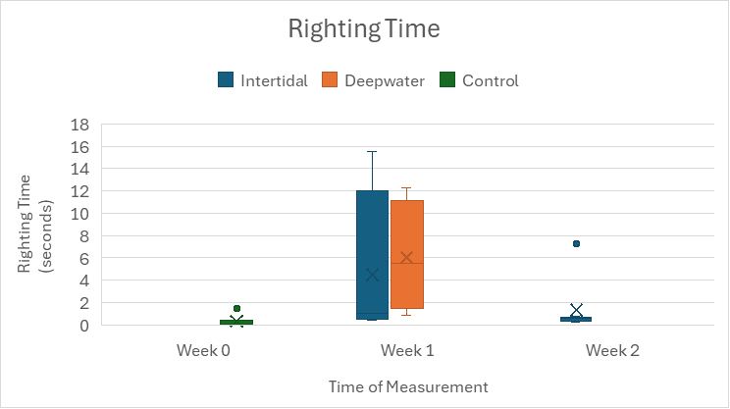
Results - Righting Time
No significant difference between treatments. Mortality meant no data from the deepwater group after Week 2.
Notes:
Mortality of crabs
Righting time results

Slide 9
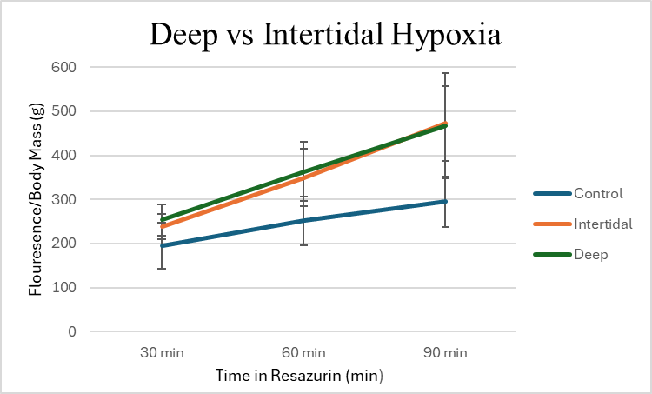
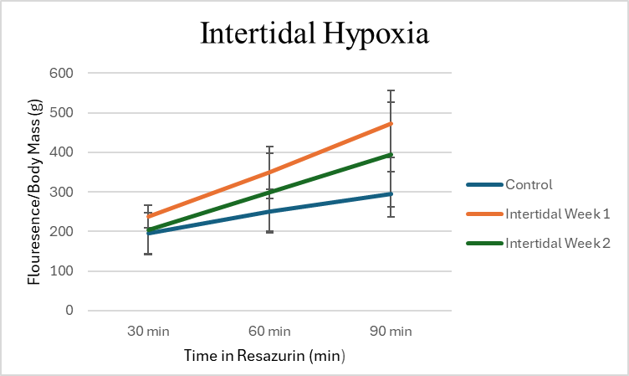
Results - Resazurin
Hypoxia treatments resulted in higher rates of respiration than control.
Week 2 intertidal resulted in lower respiration rates than Week 1.

Slide 10
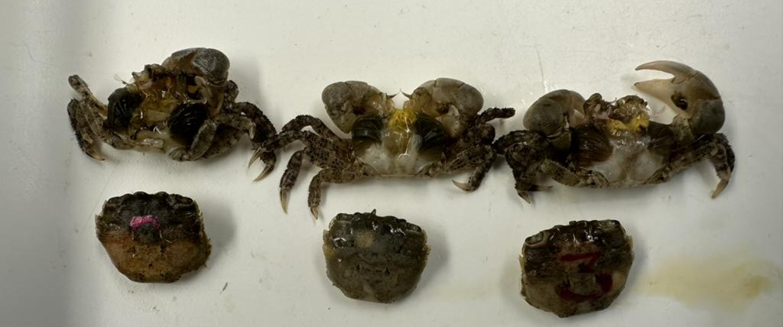
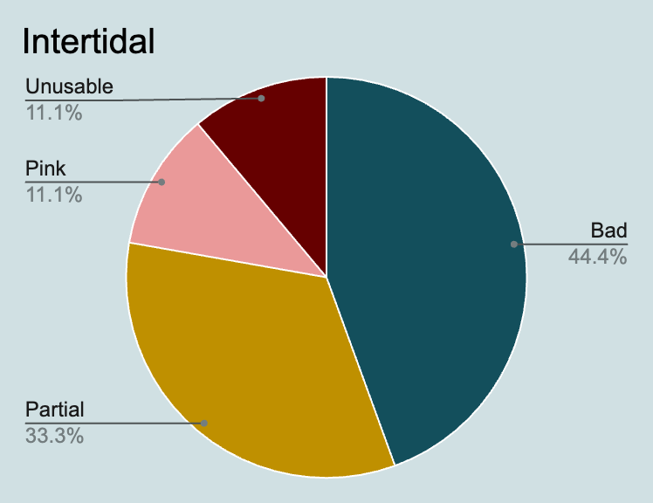
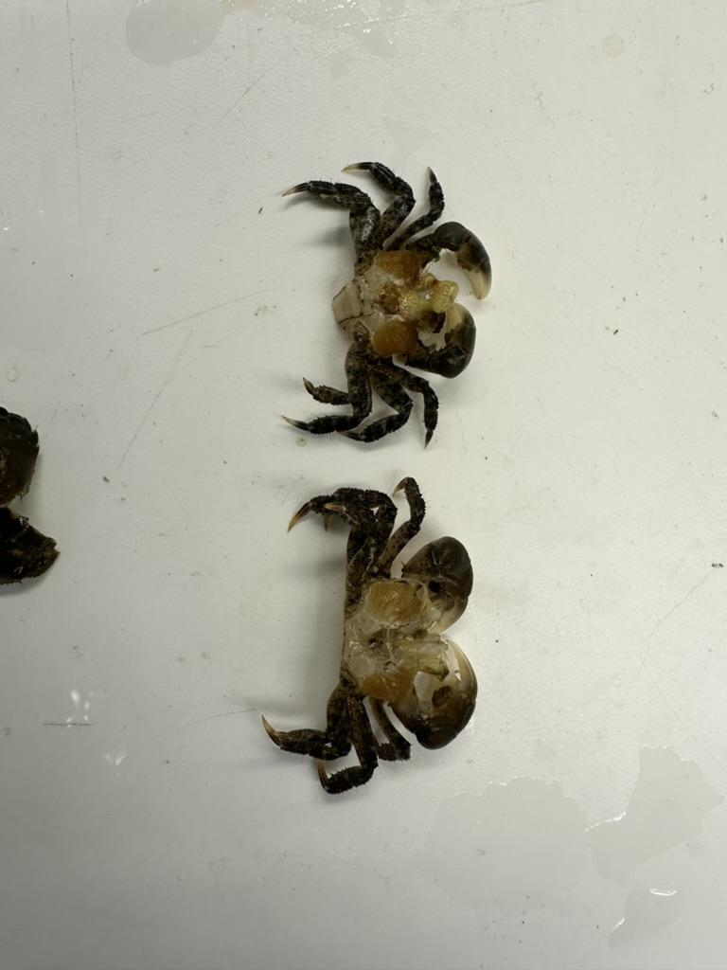
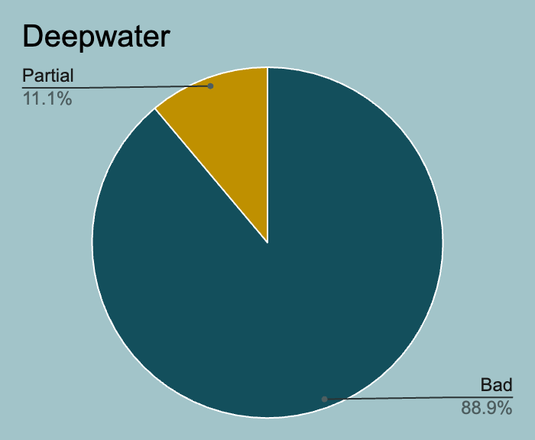
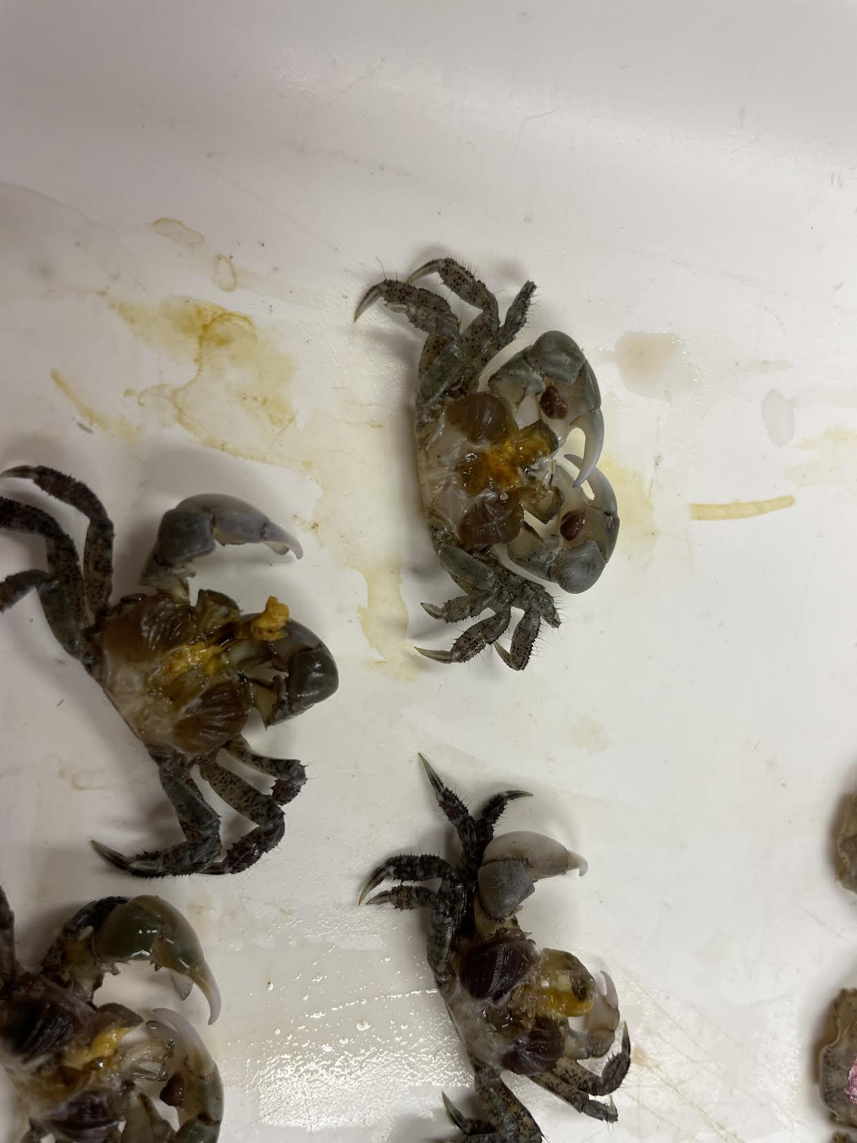
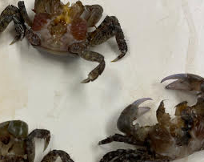
Results - Gill Tissue
Gill Tissue Key
Good | Yellow, orange-ish color
Bad | Grey, dark, atrophy
Partial | Grey with some yellow
Pink | Pink-ish possibly from resazurin
Unusable | Unable to dissect (crushed)
Deepwater
Bad
Control
Intertidal
Pink
Partial
Good
*Control - 100% good (2/2)

Slide 11
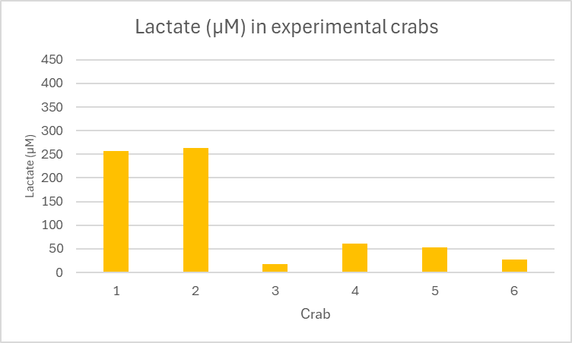
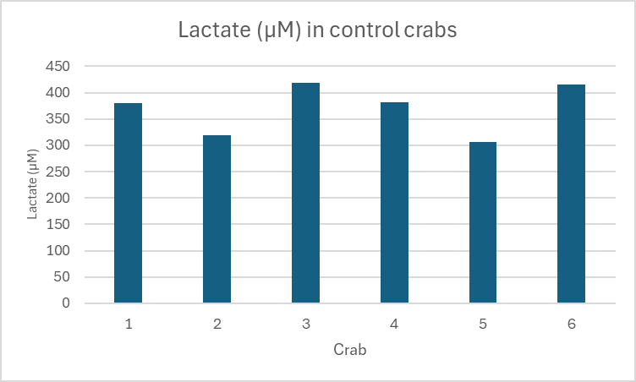
Results - Hemolymph
Some experimental crabs had slightly lower lactate than control crabs, other had extremely low levels of lactate
We expected experimental crabs to have higher levels of lactate. Lack of oxygen would make it hard to continue metabolizing normally so they might switch to anaerobic metabolism, producing more lactate. However, the opposite happened.
“Lactate paradox”: after crabs acclimate to the hypoxic conditions their lactate levels drop

Slide 12
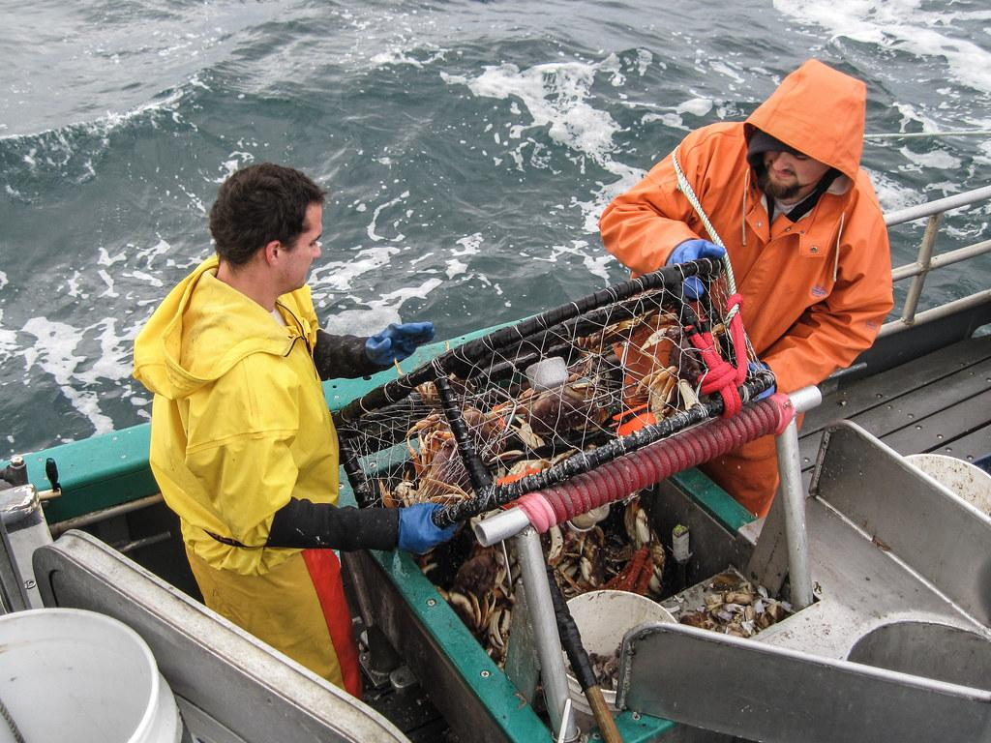
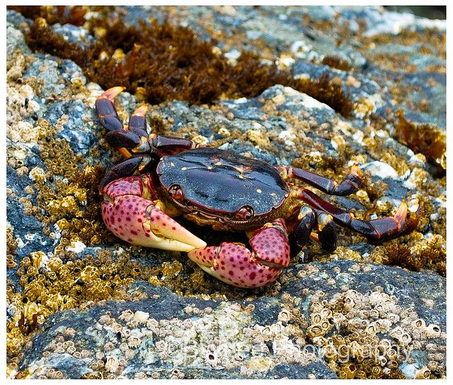
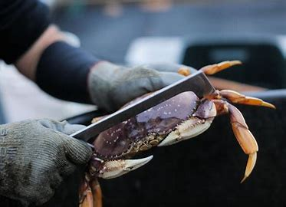
Interpretation and Conclusions
Righting time was not a strong determining factor of physiological stress
Respiration rates may be higher than control because of increased heart rate in crabs to help deliver more oxygen to the body (McGaw, 2008)
“Lactate paradox” contradicting to expected lactate levels
Gill tissue deterioration due to oxidative stress and cell decay
Implications:
Crabs have a higher chance of survival if they have access to air
Scientists and commercial crabbers can use this data to predict outcomes in crab populations and adapt to hypoxic events if possible

Slide 13
Future Work
Increased Respiration
More tests to determine the cause of increased respiration in the hypoxic treatments
Increased heart rate?
Breathing harder to increase flow of water?
Decreased Lactate
Looking more closely at the “lactate paradox”
Crab study
Run more tests to gather more data to see if this is truly what is occurring
Possible Changes to Improve Design
Addressing what could’ve been better executed and see if making those changes impact the results
Method of sealing the deepwater tank
Marking the crabs with nail polish
Finding a different method of tagging to test the difference between week 1 and week 2 crabs (tested once vs tested twice)
Try to find the time period where deepwater crabs are still alive to test their hemolymph to compare to intertidal

Slide 14
Acknowledgements
Thank you to:
José Guzmán for educating us about marine physiology.
Zach Bengtsson for helping us design our experiment and for running all of our assays.
Andy Nutzhorn for helping us design and run our experiment.

